Slide 1



Community Champions ightning Talks
Featuring the SplunkTrust and Splunk MVP

Slide 2

Seal Eye
Linux Profiles for Splunk Admins
Ryan “trex” Adler,Principal Cybersecurity Engineer, UltraViolet Cyber Splunk Trust
community.splunk.com

Slide 3

The Issue:
Pedestrian terminal experiences
Boilerplate hostname conventions
Paging through command history until you get to the one command that had a typo and it doesn’t work again
“I love having to type tail -f /opt/splunk/var/log/splunk/splunkd.log every time I troubleshoot.”
- Statements dreamed up by the utterly deranged

Slide 4
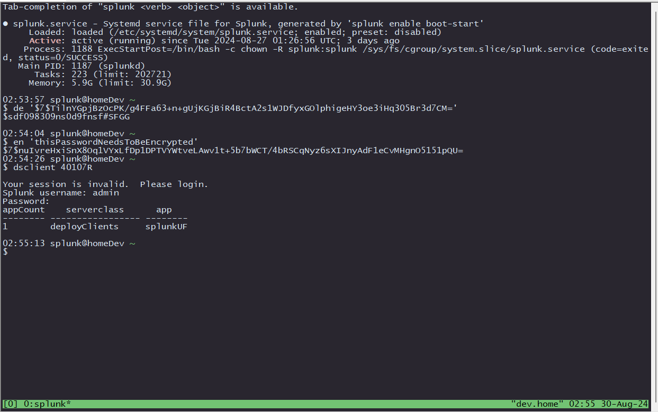
The Solution:
Introduce logical naming and identification
Make the bash experience repeatable and translatable
Create custom aliases and functions that operate in an efficient and educational manner

Slide 5

Prerequisites
For the fullest experience, internet access is required. That doesn’t mean your endpoint has to have internet, but you do. Most of the visuals are set up for dark mode users.
Decide if you are enabling these features individually, or as a team. This can be done at a system wide level (assuming you have system root) or by user.
Applications utilized:
git
tree
vim
tmux
Repositories:
github.com/ryanadler/bashful
github.com/yorokobi/vim-splunk

Slide 6
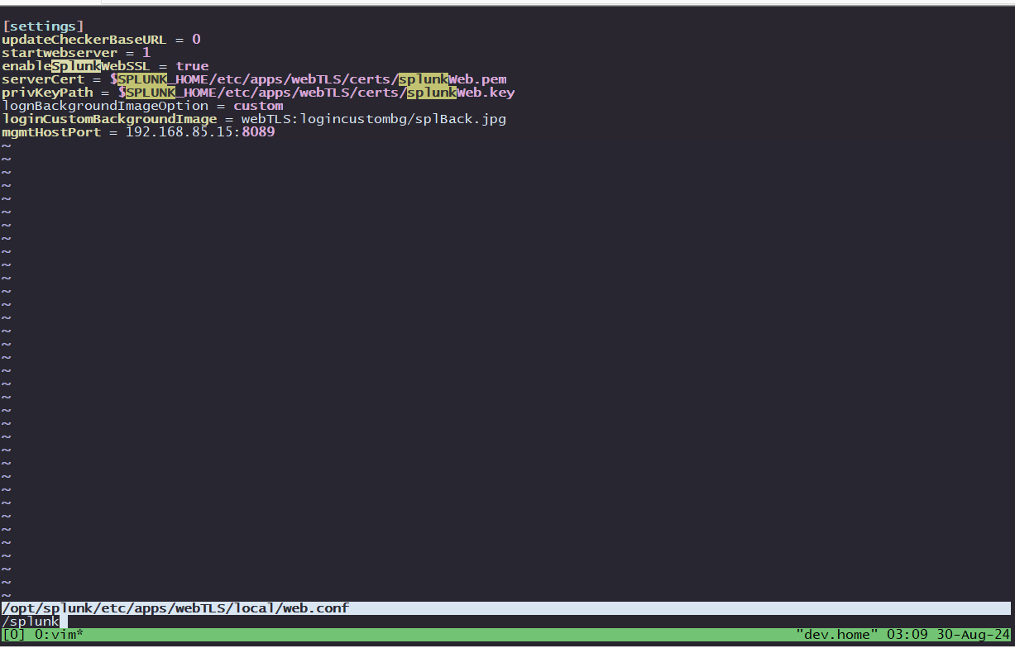
Customizing VIM
There are two key customization points for VIM. The first, is in how VIM operates and what information it displays. The second is how Yorokobi’s VIM Splunk highlighter makes sure you aren’t mucking about.
Benefits:
Case insensitive searching and live highlighting.
Presents which file you are editing, and sets color schemes to dark bg
Splunk VIM pack immediately calls out typos that may result in service failure, or an error in attempted configuration

Slide 7
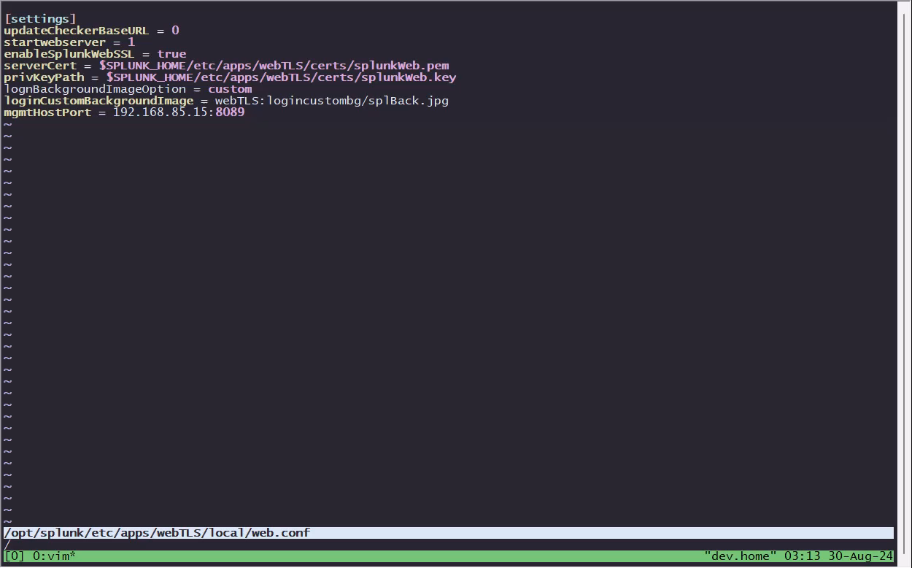
Customizing VIM
There are two key customization points for VIM. The first, is in how VIM operates and what information it displays. The second is how Yorokobi’s VIM Splunk highlighter makes sure you aren’t mucking about.
Benefits:
Case insensitive searching and live highlighting.
Presents which file you are editing, and sets color schemes to dark bg
Splunk VIM pack immediately calls out typos that may result in service failure, or an error in attempted configuration

Slide 8
Customizing Bash
A combination of an updated bash_profile and imported shortcut sources.
Benefits:
Cleaner and more informative interactions
Individual and team based customizations
Easier Splunk operations

Slide 9
Benefits of utilizing baseline configurations
Gains in bash
Gains in git
Gains in splunk
Creates easy to read lists with tree
Creates tools for interacting with git
Add/Status/Pull/Push
Puts a timestamp on your history
Colors for darkmode
Provides a place to institute practical system names without messing with hostnames
Sources git branch interactions, splunk tools, and starts tmux
Creates visual indications for branch name, changes
Trims the directory to the nearest ending 3rd, easing deep in path navigation
Creates common shortcuts for Splunk admins.
Tail splunkd
See what apps a deployment client is assigned
Reload the DS
Encrypt and Decrypt values from conf files
Validate and Push bundles; bundle push can be configured to be useful on both a SHCD and CM

Slide 10


Anecdotes
We’ve all had that co-worker. The one who’s “have a minute?” slack/teams/text is never just a minute.
Make the environment digestible for someone new
Instituting this in consulting means that the expectation for navigation and available tools is the same between shifts and different admins
Utilize echo’d explanations and comments to educate and remind people how a command is structured.

Slide 11

Questions!
Contact
Slack: @trex
Email: adlerryl@proton.me
Github: github.com/ryanadler

Slide 13
Thank you
community.splunk.com

